Slide 1
Duoquest: A Dual-Specification System for Expressive SQL Queries
Christopher Baik*
Zhongjun (Mark) Jin
Michael Cafarella
H. V. Jagadish
University of Michigan – Ann Arbor
*Currently at University of Washington

Slide 2
Agenda
Motivation
Approach
Experiments
Conclusion

Slide 3
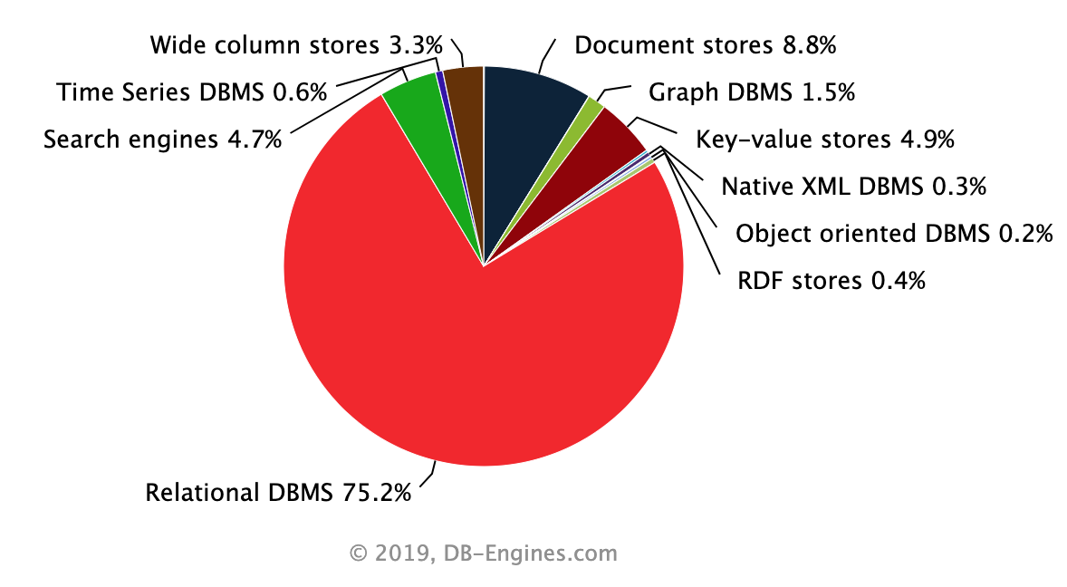
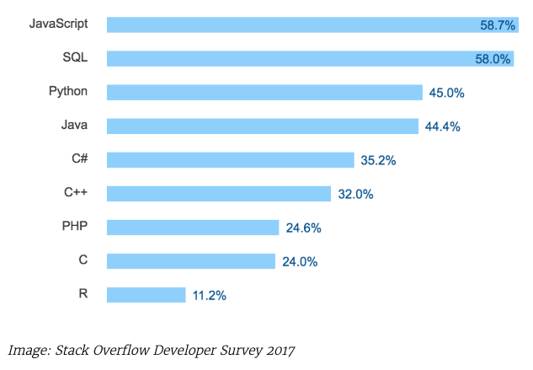
Relational DBs and SQL are popular
RDBMS: Most popular DB model
(according to web mentions)
SQL: Essential developer skill
(used to access RDBMS)
Motivation > Approach > Experiments > Conclusion

Slide 4
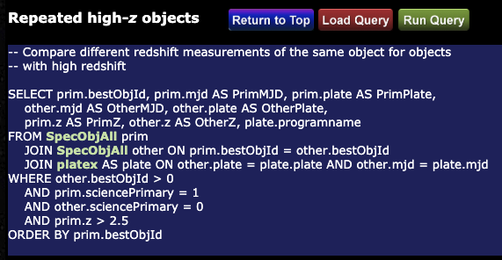
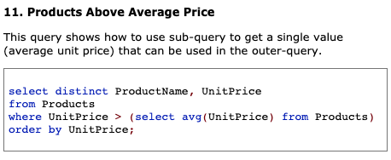
SQL can be challenging
Astronomy: Sloan Digital Sky Survey
Business: Northwind example database
🤔
SQL syntax/semantics
Schema details
Motivation > Approach > Experiments > Conclusion

Slide 5


Potential solutions for non-experts
1. Learn SQL (Costs ⏳)
Relational
Database(s)
2. Hire Technical Middlemen (Costs 💸)
Non-expert/
Occasional Users
Businesspeople
Scientists
Health Providers
etc…
3. Build More User-friendly Tools
The Great Database Chasm
Motivation > Approach > Experiments > Conclusion

Slide 6

Background: Alternatives to SQL
Natural Language Interfaces (NLI)¹
User explains their desired query in natural language;
System produces SQL queries
¹Li and Jagadish, 2014; Yaghmazadeh et al. 2017; Yu et al. 2018; etc.
Motivation > Approach > Experiments > Conclusion

Slide 7
Background: Alternatives to SQL
Scenario: Find movies released before 1995 starring Tom Hanks on a movie database
NATURAL LANGUAGE INTERFACE (NLI)
Sample System Results
SELECT m.name FROM movies m WHERE m.year < 1995 AND m.name LIKE ‘%Tom Hanks%’
SELECT m.name FROM director d JOIN directed dr ON d.did = dr.did JOIN movies m ON m.mid = dr.mid WHERE m.year < 1995 AND d.name = ‘Tom Hanks’
SELECT m.name FROM actor a JOIN cast c ON a.aid = c.aid JOIN movies m ON m.mid = a.mid WHERE m.year < 1995 AND a.name = ‘Tom Hanks’
(Get movies before 1995 with substring ‘Tom Hanks’)
(Get movies before 1995 directed by Tom Hanks)
User Specification
Find all Tom Hanks movies before 1995.
(Get movies before 1995 with actor Tom Hanks)
Motivation > Approach > Experiments > Conclusion

Slide 8
Background: Alternatives to SQL
Natural Language Interfaces (NLI)¹
User explains their desired query in natural language;
System produces SQL queries
Expressive, but not accurate
Users can describe expressive queries, including aggregates
Inherent ambiguity
State-of-the-art: Top-1 accuracy only ~60% on prominent benchmark²
¹Li and Jagadish, 2014; Yaghmazadeh et al. 2017; Yu et al. 2018; etc.
²https://yale-lily.github.io/spider
Motivation > Approach > Experiments > Conclusion

Slide 9


Background: Alternatives to SQL
Natural Language Interfaces (NLI)¹
Programming by Example (PBE)³
User explains their desired query in natural language;
System produces SQL queries
User provides examples of output rows from their desired query;
System produces SQL queries
Expressive, but not accurate
Users can describe expressive queries, including aggregates
Inherent ambiguity
State-of-the-art: Top-1 accuracy only ~60% on prominent benchmark²
¹Li and Jagadish, 2014; Yaghmazadeh et al. 2017; Yu et al. 2018; etc.
²https://yale-lily.github.io/spider
³Zloof, 1975; Psallidas et al. 2015; Fariha and Meliou, 2019; etc.
Motivation > Approach > Experiments > Conclusion

Slide 10
Background: Alternatives to SQL
Scenario: Find movies released before 1995 starring Tom Hanks on a movie database
PROGRAMMING BY EXAMPLE (PBE)
Sample System Results
SELECT m.name, m.year FROM movies m
SELECT m.name, m.year FROM movies m WHERE m.year < 1995
SELECT m.name, m.year FROM movies m WHERE m.year > 1987
4. …many more, esp. with more expressivity…
(Get all movies)
(Get movies before 1995)
User Specification
[Forrest Gump, 1994]
[Big, 1988]
(Get movies after 1987)
Motivation > Approach > Experiments > Conclusion

Slide 11
Background: Alternatives to SQL
Natural Language Interfaces (NLI)¹
Programming by Example (PBE)³
User explains their desired query in natural language;
System produces SQL queries
User provides examples of output rows from their desired query;
System produces SQL queries
Expressive, but not accurate
Accurate, but not expressive
Users can describe expressive queries, including aggregates
Inherent ambiguity
State-of-the-art: Top-1 accuracy only ~60% on prominent benchmark²
Resulting queries are “sound” – guaranteed to satisfy input
More expressivity leads to much larger set of queries displayed to user
¹Li and Jagadish, 2014; Yaghmazadeh et al. 2017; Yu et al. 2018; etc.
²https://yale-lily.github.io/spider
³Zloof, 1975; Psallidas et al. 2015; Fariha and Meliou, 2019; etc.
Motivation > Approach > Experiments > Conclusion

Slide 12
Our research question…
+
Natural Language Interfaces (NLI)
Expressive, but not accurate
Programming by Example (PBE)
Accurate, but not expressive
Can we get the best of both worlds:
expressive and accurate?
Motivation > Approach > Experiments > Conclusion

Slide 13
Agenda
Motivation
Approach
Demo
Algorithm Details
Experiments
Conclusion

Slide 14

Motivation > Approach > Experiments > Conclusion
Notes:
Pause after video starts, highlight the NLI and PBE components of the interface

Slide 15
Agenda
Motivation
Approach
Demo
Algorithm Details
Experiments
Conclusion

Slide 16


Algorithm Goals
1. Accuracy Synthesize the user’s desired query in top-n results
2. Efficiency Operate in interactive time
Motivation > Approach > Experiments > Conclusion

Slide 17
Algorithm Overview
NLQ: Find all Tom Hanks movies before 1995.
PBE: [Forrest Gump, 1994]
[Big, 1988]
+
∅
Each node is a partial query
Lower layers are more “concrete” versions of previous layers (Note: figure is simplified)
Leaf nodes are executable queries
SELECT ?
FROM ?
SELECT ? FROM ?
WHERE ?
…
SELECT name, ?
FROM actor
WHERE ?
SELECT title, ?
FROM movie
WHERE ?
…
SELECT title, year
FROM movie
WHERE year < 1995
SELECT title, year
FROM movie
WHERE year > 1995
…
Motivation > Approach > Experiments > Conclusion

Slide 18
Algorithm Overview
NLQ: Find all Tom Hanks movies before 1995.
PBE: [Forrest Gump, 1994]
[Big, 1988]
+
∅
O(c^{n}) space, n is # cols in schema
Which branches do we explore first?
How do we prune search space?
Super naïve approach: Breadth-first search, execute each leaf node
Our approach: Guided partial query enumeration (GPQE)
Guidance: syntax tree net (deep learning)
Pruning: use partial queries to prune early
SELECT ?
FROM ?
SELECT ? FROM ?
WHERE ?
…
SELECT name, ?
FROM actor
WHERE ?
SELECT title, ?
FROM movie
WHERE ?
…
SELECT title, year
FROM movie
WHERE year < 1995
SELECT title, year
FROM movie
WHERE year > 1995
…
Motivation > Approach > Experiments > Conclusion

Slide 19
Pruning: Minimize Number of Verifications
NLQ: Find all Tom Hanks movies before 1995.
PBE: [Forrest Gump, 1994]
[Big, 1988]
+
∅
Why? Verifications cost ⏳
Naïve: Independently execute and verify each leaf node
Solution: Avoid redundant verifications, test partial queries
SELECT ?
FROM ?
SELECT ? FROM ?
WHERE ?
…
…
…
…
SELECT m.genre, m.year FROM … WHERE m.year <= 1995 AND a.name = ‘Tom Hanks’
SELECT m.genre, m.year FROM … WHERE m.year < 1995 AND a.name = ‘Tom Hanks’
Motivation > Approach > Experiments > Conclusion

Slide 20
Pruning: Minimize Number of Verifications
NLQ: Find all Tom Hanks movies before 1995.
PBE: [Forrest Gump, 1994]
[Big, 1988]
+
∅
Why? Verifications cost ⏳
Naïve: Independently execute and verify each leaf node
Solution: Avoid redundant verifications, test partial queries
SELECT ?
FROM ?
SELECT ? FROM ?
WHERE ?
…
…
…
SELECT m.genre, ?
FROM ? WHERE ?
SELECT m.genre, m.year FROM … WHERE m.year <= 1995 AND a.name = ‘Tom Hanks’
SELECT m.genre, m.year FROM … WHERE m.year < 1995 AND a.name = ‘Tom Hanks’
Motivation > Approach > Experiments > Conclusion

Slide 21
Agenda
Motivation
Approach
Demo
Algorithm Details
Experiments
Conclusion

Slide 22
User Studies Setup
16 users with no schema knowledge
10 with some SQL experience
6 with little to none
2 studies for different supported workloads
8 tasks (Duoquest vs. state-of-the-art NLI)
6 tasks (Duoquest vs. state-of-the-art PBE)
Fact Bank: 10 facts provided per task to control domain knowledge
Motivation > Approach > Experiments > Conclusion

Slide 23
User Study vs. NLI – Accuracy
62.5% absolute increase in total # of successful trials
Higher accuracy on each task
0% accuracy on NLI for A3, A4, B4
Motivation > Approach > Experiments > Conclusion

Slide 24
User Study vs. PBE – Accuracy
Performed on a more limited workload supported by PBE
Duoquest has comparable or higher accuracy over PBE on all tasks
Motivation > Approach > Experiments > Conclusion

Slide 25
Simulation Study - Setup
Tested on Spider benchmark (Yu et al, 2018)
10,181 NLQ-SQL pairs on 200 databases
Split into training/dev/test sets
For PBE spec: executed SQL and randomly selected 1-2 example rows
Compared approaches
System | NLQ | PBE
Duoquest | ✓ | ✓
NLI | ✓
PBE |  | ✓
Motivation > Approach > Experiments > Conclusion

Slide 26
Simulation Study – Accuracy
27.0% ↑
Duoquest/NLI returns ranked list of queries
Top-10 accuracy: % tasks where the desired query was ranked in top 10
PBE returns set of candidate filters
”Correct” if true filters ⊆ actual filters
>27% absolute increase in top-10 accuracy over single-specification approaches (NLI, PBE)
29.4% ↑
Motivation > Approach > Experiments > Conclusion

Slide 27
Simulation Study – Accuracy
Duoquest/NLI returns ranked list of queries
Top-10 accuracy: % tasks where the desired query was ranked in top 10
PBE returns set of candidate filters
”Correct” if true filters ⊆ actual filters
>27% absolute increase in top-10 accuracy over single-specification approaches (NLI, PBE)
PBE could not support ~80% of tasks
Motivation > Approach > Experiments > Conclusion

Slide 28
Agenda
Motivation
Approach
Demo
Algorithm Details
Experiments
Conclusion

Slide 29
Takeaways
Problem: Relational databases can be hard to query for non-experts
Solution: Dual-specification interface combining NLI + PBE
User Study Results:
62.5% absolute increase in accuracy in over NLI
Comparable performance to PBE on more-limited PBE-supported workload
Simulation Study: >27% absolute increase in top-10 accuracy on Spider over NLI/PBE
Thank you! cjbaik@cs.washington.edu
Motivation > Approach > Experiments > Conclusion

Slide 30
User Study vs. PBE – Task Time
PBE is faster on easier tasks (C1, C2, D1, D2)
Due to time required to write out natural language query
Comparable time on harder tasks (C3, D3)
Motivation > Approach > Experiments > Conclusion

Slide 31
User Study vs. NLI – Task Time
Duoquest reduces or has comparable task time to NLI on each task
Motivation > Approach > Experiments > Conclusion

Slide 32
Simulation Study – Algorithm Performance
Spider Dev results shown
Spider Test had similar results
Compared Algorithms
Duoquest: full algorithm
NoGuide: disable NLQ guidance
NoPQ: disable pruning partial queries
Performance suffers immensely when disabling either component
Motivation > Approach > Experiments > Conclusion

Slide 33
User Study vs. PBE – # Examples Used
Duoquest uses significantly less examples than PBE
Natural language replaces the need for more examples
Motivation > Approach > Experiments > Conclusion

Slide 34
Pruning: Minimize Per-Query Verification Time
PBE: [Forrest Gump, 1994]
[Big, 1988]
Intuition: Prune as early as possible, in order of faster-executing to slower methods.
Candidate (Partial) Queries
SELECT AVG(title), ? FROM movie
SELECT genre, ? FROM movie
SELECT title, year FROM movie m JOIN cast c ON c.mid = m.mid JOIN actor a WHERE a.name = ‘Tom Hanks’
Semantic validity
Cheap, join-less query for partial queries with incomplete SELECT SELECT 1 FROM movie WHERE genre = ‘Forrest Gump’
More expensive query for row-wise match SELECT 1 FROM movie m JOIN cast c ON c.mid = m.mid JOIN actor a ON c.aid = a.aid WHERE m.title = ‘Forrest Gump’ AND m.year = 1994 AND a.name = ‘Tom Hanks’
Verification Time Cost
Motivation > Approach > Experiments > Conclusion

Slide 35
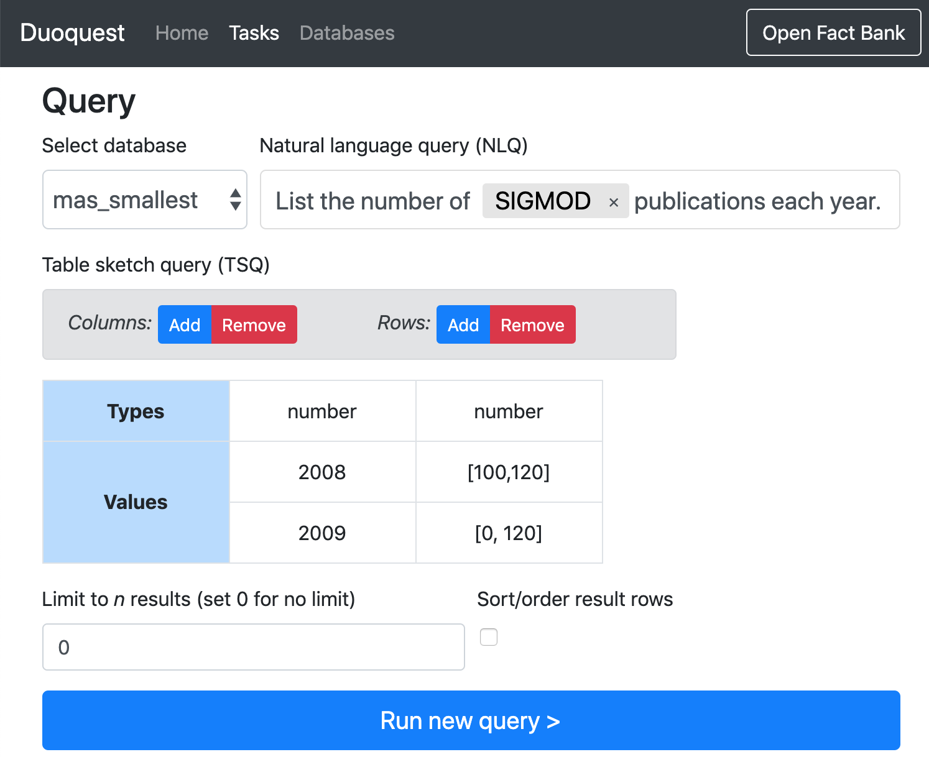
Demo Recap
User provides NLQ
Optional PBE example tuples and additional metadata
Autocomplete for specific text values in database
User can preview/execute candidate queries
Motivation > Approach > Experiments > Conclusion

Slide 36
Icons
AomAm from the Noun Project
Motivation > Approach > Experiments > Conclusion

